Slide 1
AUTOMATIC GARBAGE CLASSIFICATION USING DEEP LEARNING
Presented By GROUP 13
MUHAMMED A V VDA18CS026
MUHAMMED K K VDA18CS027
MUHAMMED WASEEM VDA18CS030
SWALIH N C VDA18CS044
Guided By
FAFLI KAREEM A P
Asst. Profressor
Dept. of CSE

Slide 2
TABLE OF CONTENT
MOTIVATION
ABSTRACT
INTRODUCTION
PROPOSED SYSTEM
MODULES
DFD LEVEL 0
DFD LEVEL 1
CONCLUSION
REFERENCE

Slide 3
MOTIVATION
To Develop Eco-friendly Society
Reduces Human Efforts of manual seggregation & Time Consummation
Avoid User Confusion
Role-model for Future Generation
Predictive after Effect is Unpredictable

Slide 4
ABSTRACT
Improve the Efficiency of Waste Management Using
Deep Learning
Machine learning Tool
Mining of Data
Arduino Uno — Automatic Classification
Classification —Biodegradable/Non Biodegradable

Slide 5
INTRODUCTION
Smart Garbage Classification Using Machine Learning Tool
Force sustainable systems of waste collection, segregation & treatment with a controlled, systematic and creative ways of reducing waste generation
Prevents Germs and Fungus - Closed System
Deepest Learning of Images - Increase the Accuracy of Machine

Slide 6
PROPOSED SYSTEM
Able to automate the solid waste monitoring process
Able to the management of the overall collection process using IOT
Consists of main subsystems namely Smart Trash System(STS) and Smart Monitoring and Controlling Hut(SMCH).
Uses to dispose, reduce, reuse, and prevent waste.
Possible waste disposal methods are recycling, composting, incineration, landfills, bioremediation, waste to energy, and waste minimization

Slide 7
MODULES
Programing Module
Arduino Module
Hardware Module
Mining of Data set from different Resources
Servo Motor connection b/w Programmable module
Garbage Bin with Two Modes
1
2
3

Slide 8
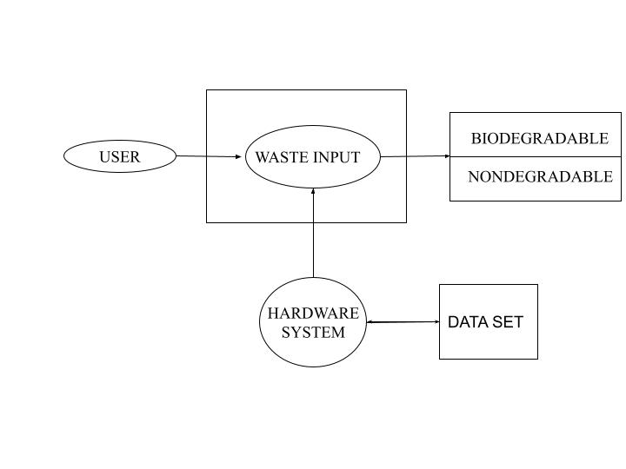
USE CASE DIAGRAM

Slide 9
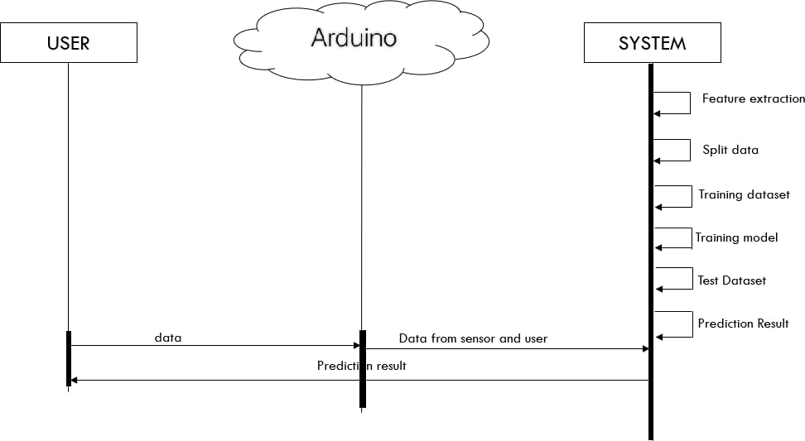
SEQUENCE DIAGRAM

Slide 10
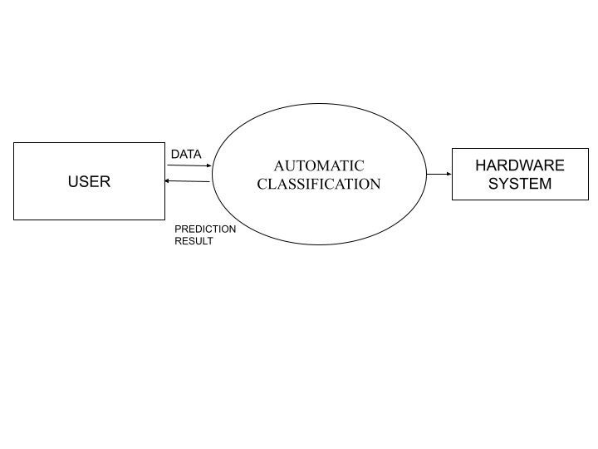
DFD LEVEL O

Slide 11
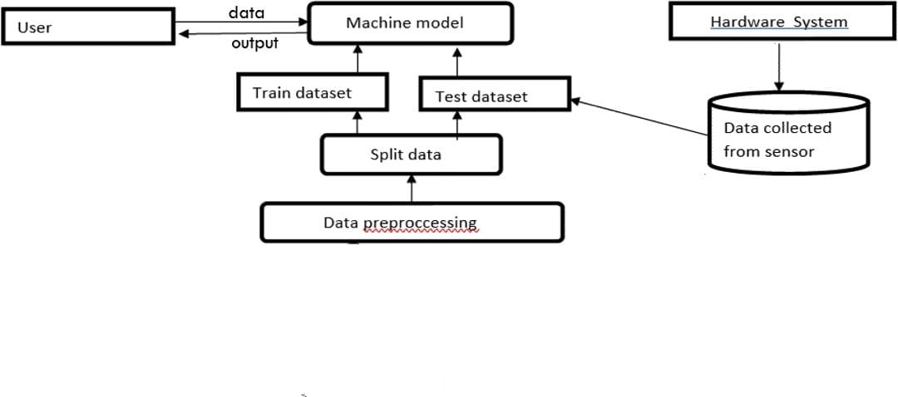
DFD LEVEL 1

Slide 12
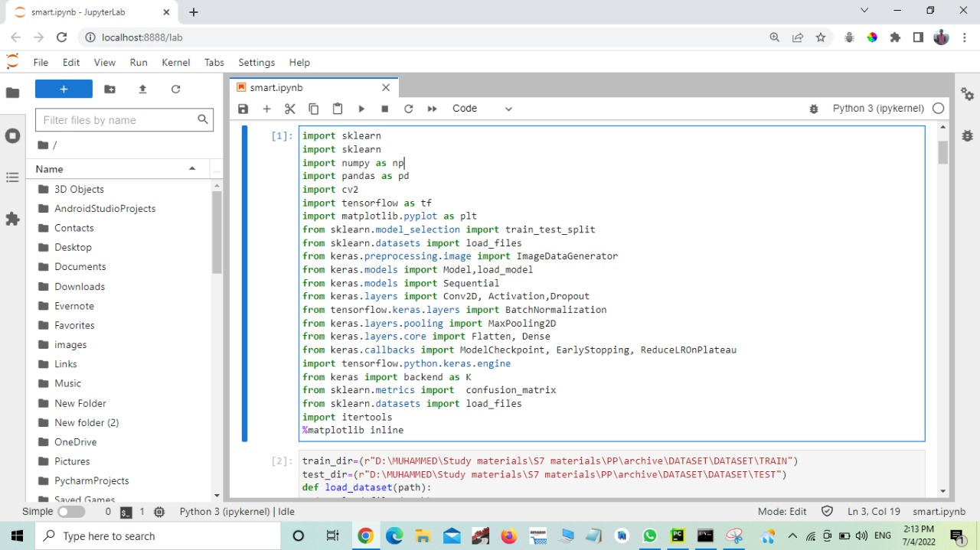
IMPLEMENTATION

Slide 13
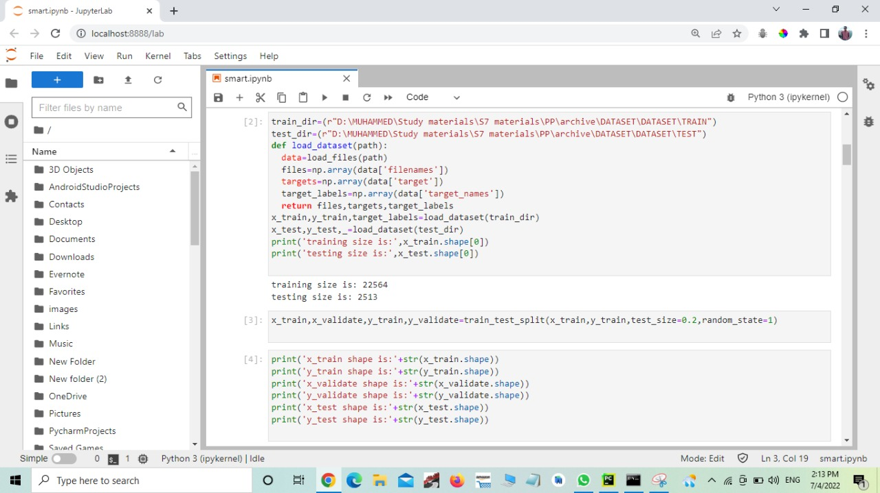
IMPLEMENTATION

Slide 14
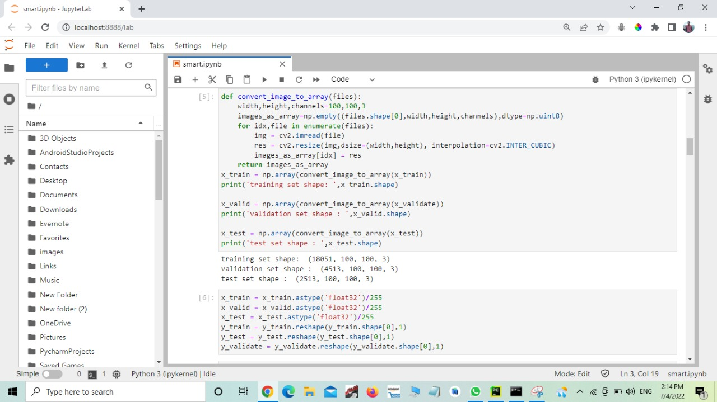
IMPLEMENTATION

Slide 15

IMPLEMENTATION

Slide 16
CONCLUSION
Change Socio-Economic Culture of the Society
Error-less Response on Implemented Data set
Efficient Time Management
Best Result for these Model

Slide 17
RESULT
Implemented Model Get Best Response From Public
Image Sensing Used for Classifcation
Almost all Test is Accurate
Garbage is either Biodeggradable or Non Biodeggradable

Slide 18
REFERENCE
D. Porshnov, V. Ozols, and M. Klavins, ‘‘Thermogravimetric analysis as express tool for quality assessment of refuse derived fuels used for pyrogasification,’’ Environ. Technol., vol. 41, no. 1, pp. 35–39, Mar. 2020.
W. Pereira, S. Parulekar, S. Phaltankar, and V. Kamble, ‘‘Smart bin (waste segregation and optimisation),’’ in Proc. Amity Int. Conf. Artif. Intell. (AICAI), Dubai, United Arab Emirates, Feb. 2019, pp. 274–279.

Slide 19
REFERENCE
P. Kellow, R. J. P. C. Joel, D. Ousmane, D. A. Kumar, D.-A. C. V. Hugo
and K. A. Sergei, "A smart waste management solution geared
towards citizens", Sensors, vol. 20, no. 8, pp. 1-15, Apr. 2020.
Y.-G. Cheng, N. Chen and H. Zhang, "Coal fly ash as an inducer to
study its application in the production of methane gas from domestic
waste", Fresenius Environ. Bull., vol. 29, no. 2, pp. 1082-1089, 2020

Slide 20
THANK YOU

